Slide 1
Multimodal First Person Sensing System Overview
Qifan Hu
Carnegie Mellon University

Slide 2
Motivation
Found a book in retail store and want to know how good it is. You can
Use mobile devices
Look and say “How do people like this book”
Goal: Create ambient intelligent contexts
Seamless interactions between user and environment

Slide 3
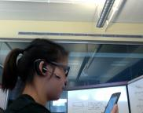
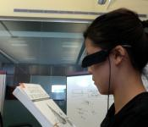

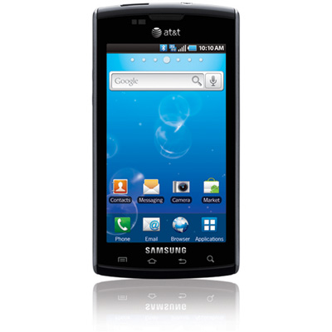
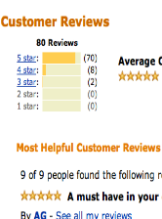
User Case
Activate System
Look at Object/Human
Say Commands
Book
“How do people like this book”
<trigger word>
Receive Response
Amazon book review

Slide 4
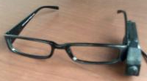
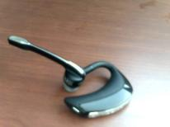
Introduction
Multimodal First Person Sensing (MMFPS)
Integrate results from both speech recognizers and vision recognizers
Allow intelligent interaction between the user and the environment
Current components:
Device: First-person camera, microphone
Speech recognizer: PocketSphinx (CMU)
Object recognizer: Exemplar-SVM (CMU) [1]
Face recognizer: OpenCV
Integrator: Bayesian network
Workstation based user interface: Linux
Mobile based user interface: Android
[1]. T. Malisiewicz, A. Gupta and A. A. Efros, “Ensemble of Exemplar-SVMs for Object Detection and Beyond”, ICCV 2011

Slide 5
Original Architecture
Face
Commander
Feedback
Talker
System
Trigger
Retail Object
Commander
BayesNet
Integrator
Face
Recognizer
Graphical Interface
Location
Recognizer
Retail Object
Recognizer
Responder
Audio
Video

Slide 6
System Architecture Reorganized
Feedback
Talker
a
Face Manager
Face Commander
BayesNet
Integrator
Face Recognizer
System
Trigger
a
Object Manager
Graphical Interface
Object Commander
Location
Recognizer
Object
Recognizer
Responder
Audio
Video

Slide 7
General Architecture
a
Feedback
Talker
Face Manager
Face Commander
Face Recognizer
Emotion Recognizer
BayesNet
Integrator
System
Trigger
A
Object Manager
Graphical Interface
Object Commander
Retail Obj
Recognizer
Responder
Location
Recognizer
Office Obj
Recognizer

Slide 8
Module Structure
A whole module serve for a general purpose
One scenario has one recognition module, with 5 components:
Manager, commander, recognizer, integrator and library
Manager: read/write/update data for the module, control the flow
Commander: speech recognizer to issue scenario command
Recognizer: vision recognizer to detect specific face/object
Integrator: machine learning models to integrate results for each module
Integrator not designed yet
Manager
Commander
Recognizer
Integrator

Slide 9
Module Code Management
Project Package
……
All codes in one module put together to ensure consistence
Better scalability and extensibility, easy to add one whole sensing module
E.g. Motion recognition module
Absence of one part (commander) does not affect the module performance
Module 1
Module N
Data Library
Manager
Commander
Recognizer
Integrator

Slide 10
Module Data Management
Project Package
……
……
All data is dynamically managed by module Manager (will explain later)
Solve the data issue very nicely
Module 1
Module N
Data Library
Data 1
Data N
Manifest
Speech Models
Vision Exemplars
ML Confusion Matrix

Slide 11
Module Data Manifest
XML format
Two manifest files for each module:
one for commands, one for objects
Command manifest: Object manifest:
All nodes/modules share the same manifest design
All nodes/modules communication share the same format
<command id=“cmd1">
<name>information</name>
</command>
<command id=“cmd2">
<name>option</name>
</command>
<face id="face1">
<name>Denver</name>
<gender>1<gender>
<location>office</location>
</face>

Slide 12
Module Structure Revisited
Command
Manifest
XXX
Manager
Object
Manifest
Language Model
XXX
Commander
XXX
Recognizer
SVM Exemplars
Vocabulary
XXX
Integrator
ML Confusion Matrix
Audio
Video
Code
Data

Slide 13
Module: Manager*
Read command/object manifest
Insert/delete/update data entries dynamically
When data updated, inform all recognizers to reload data
For example, add a new object “Phone”
Update object manifest
Update vision exemplar set
The phone exemplars should already exist in the library
but not necessarily used in specific purposes
Update speech language models/vocabulary
Update confusion matrix
Inform relevant recognizers to update data

Slide 14
Commander*/Recognizer* (Wrapper)
Manager: read/write/update data for this node
Internal Service: resume/pause/update
External Service: resume/pause/update other nodes
Source Subscriber/Parser: video/audio source
Param Subscriber/Parser: update the params
Message Subscriber/Parser: outputs of other nodes
Result Parser/Publisher: output of this node
Recognizer_Initialize (library_data, fixed_params)
Result = Recognize (source, params)

Slide 15
Communication Protocol
Generally, ROS publishing/subscription
Publisher node publishes messages to the system space
Subscriber node gets the message and parses it
Each single node can have multiple publishers and subscribers
Protocol: binary communication
E.g. face command library: [recognize, train, update]
Face object library: [denver, fanyi, qifan]
Face commander detects “recognize qifan”
The data transferred is actually “1 0 0” and “0 0 1”
Advantages:
Concise and consistent communication
Easy to parse and use

Slide 16
System Launching
XML format
Activate/deactivate one specific module by one activation parameter
Launch/close all system nodes in one click
<launch>
<param name=“xxxActivation” value=“true” />
<param name=“xxxLibraryPath” value=“...” />
<node name=“xxxManager” pkg=“…” type=“…” output=“…” />
<node name=“xxxCommander” pkg=“…” type=“…” output=“…” />
<node name=“xxxRecognizer” pkg=“…” type=“…” output=“…” />
<node name=“xxxIntegrator” pkg=“…” type=“…” output=“…” />
</launch>

Slide 17
MMFPS - Speech Recognition

Slide 18
Dialog System Architecture
Open Language Mode
Closed Language Mode
<Trigger Word>
Feedback Talker
System Trigger
Dialog Manager
Retail Obj
Commander
Face
Commander
Office Commander
... …
<Query Command>
Retail Tasks
Face Names
Office Tasks
Automatically go back when one task done
If N scenarios, then N+1 speech recognizers

Slide 19
Module Nodes
Trigger Recognizer:
Keep the system silent until the user calls the system
Once triggered, deactivated until actual commands issued
Command Recognizer:
Different Language models and vocabulary for different scenarios
Parses the user input and publish results
Dialog Manager:
Controls the activation and deactivation of all recognizers
Activate either trigger recognizer or command recognizers
Feedback Talker:
Confirms with the user the recognized results

Slide 20
Personalization
Language models and vocabularies have all data included
Data manifest does not necessarily have all data entries included
For example:
In face module, Yaser and Martial are in the language models
They can both be recognizer by the speech recognizer
In face data manifest, only Yaser registered
Meaning only Yaser can be recognized, Martial does not have face models
Once Martial recognized in speech, his data will be collected and registered in the data manifest
Still experimenting

Slide 21
MMFPS - Location Recognition

Slide 22
Recognizer Library
Based on environment point cloud, retrieve location and pose information, and then object labeling information
Point cloud data:
556 images for the environment
114,664 3D points in the cloud
8 categories of objects labeled in the environment
71,675 out of 114,664 3D points labeled with objects
Most points has only 1 or 2 objects assigned
256,030 labels in total
2.23 labels per point on average
2D labeling and 3D labeling Matlab tools developed

Slide 23
Recognition Operation
Training phase:
2D labeling first, then 3D labeling based on 2D-3D correspondence
Online testing phase:
Receive an image
Retrieve 128 dimensional SIFT points
For each testing SIFT points
search all 2D SIFT points in the lib for the nearest neighbor
Map the selected point to the 3D cloud, and get the labels
Get the labels for the whole image
The labeling data is transferred to the object recognizer for actual detection

Slide 24
3D Points Examples
In total:
Book | Cap | Cup | Disk | Sweater | Toy | Tumbler | Umbrella
0 | 7 | 0 | 0 | 18 | 0 | 0 | 0
4 | 0 | 2 | 0 | 0 | 0 | 0 | 0
26 | 0 | 0 | 0 | 0 | 0 | 0 | 0
0 | 0 | 11 | 0 | 0 | 0 | 0 | 0
0 | 11 | 0 | 0 | 0 | 0 | 0 | 0
147,839 | 8,149 | 28,911 | 3,537 | 50,960 | 6,250 | 8,637 | 1,747

Slide 25
MMFPS - Object Recognition

Slide 26
Recognizer Library
52 objects, 518 images, with 10 images per object
Adapter | Airborne | Badge | Bag | Ballpen | Battery
Boot | Bottle | Bulb | Butterbar | Cable | Candy
Cap | Cup | Disk | Earphone | Envelop | Flashlight
Flower | Football | Frisbee | Golfball | Hanger | Headset
Lamp | Lock | Marker | Movie | Nailcutter | Notebook
Patchboard | Pen | Pencase | Pennant | Powder | Punch
Ruler | Sandals | Shampoo | Shotglass | Soccer | Stapler
Sticker | String | Goggles | Tape | Toothbrush | Tissue
Toy | Tumbler | Umbrella

Slide 27
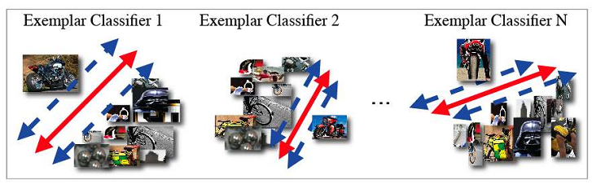
Recognizer Training
Use per-Exemplar Classifier training from [1]
Use random images from Flickr as negative examples
[1]. T. Malisiewicz, A. Gupta and A. A. Efros, “Ensemble of Exemplar-SVMs for Object Detection and Beyond”, ICCV 2011

Slide 28
Recognizer Online Testing
Detect using Trained Classifiers for each frame
Sliding Window Detection
Optimization:
Optimize the training phase
Optimize the testing phase

Slide 29
MMFPS – Bayesian Network

Slide 30
Bayesian Network
Pr(c|o)
Cmd (c)
Pr(o)
Obj (o)
Obj (o)
Speech-recognized cmd (sc)
Cmd said (c)
Pr(sc|c)
Speech-recognized obj (so)
Vision-recognized obj (vo)
Obj said (o)
Pr(so|o)
Obj seen (o)
Pr(vo|o)

Slide 31
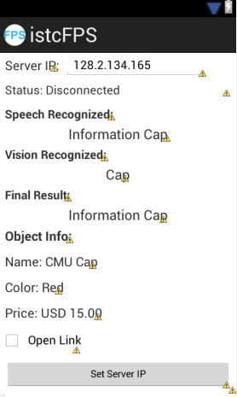
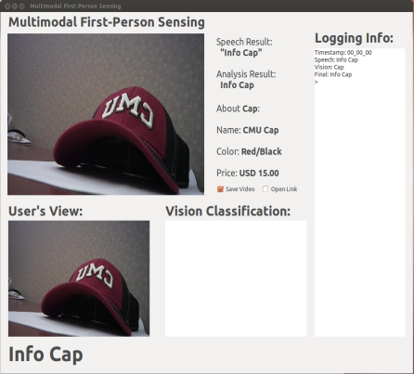



User Interface
Mobile Device
Desktop

Slide 32
MMFPS – Experiments

Slide 33
Progress and Plans
Progress:
System design and infrastructure 100% done
Speech recognition 100% done
Face recognition 80% done
Location recognition 50% done
Object recognition 0% done
Bayesian network 20% done
Plans:
Continue with the system development
Experiments

Slide 34
Work on a runnable system

